Slide 1
Command and Control
Brandon Moe

Slide 2
Todays Topics
Initialize a Joystick
Command and Control

Slide 3
How to initialize a joystick

Slide 4
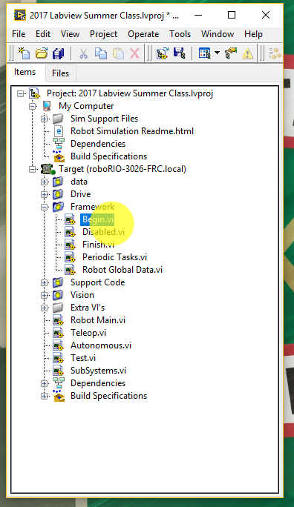
Step 1
Open Up Begin

Slide 5
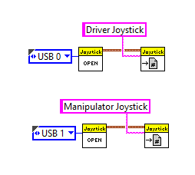
Step 2
Give Meaningful names!
Driver joystick is always USB 0
Manipulator joystick is always USB 1
Initialize Your Joysticks

Slide 6
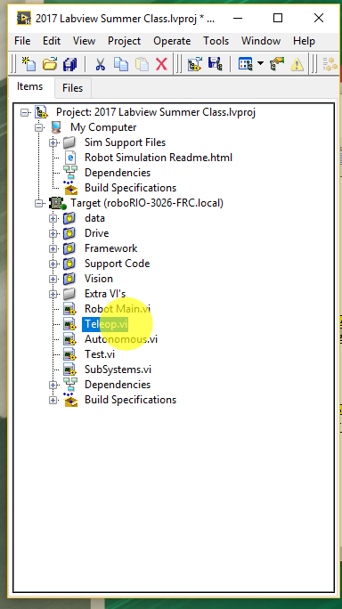
Step 3
Go to teleop

Slide 7
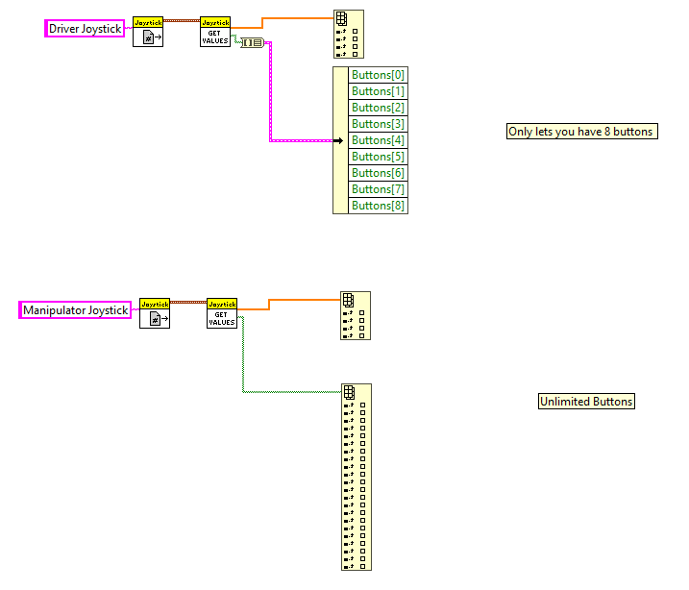
Step 4
Unbundle your joystick (this can be done two ways)

Slide 8
Command and control
The bane of Harrys existence

Slide 9
Introduction
Command and control is the process we use to program the robot
It real-time run speed is the fastest that LabVIEW offers
This is a very difficult concept to learn but is worth the benefits it offers
Remember this is a very hard concept. You will screw up at some point. Any mistakes you make I have already done and worse. It is a steep learning curve.

Slide 10
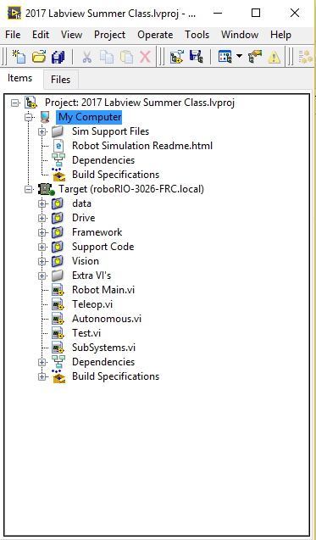
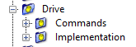
Interface
This is a snippet of a basic drive system
There are two main parts
Commands
Implementation

Slide 11
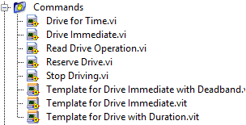
Commands
Commands are the actions you want to preform
These will be placed in teleop
Anything you want the robot to do needs a command
In C++ these are called header files example.h

Slide 12
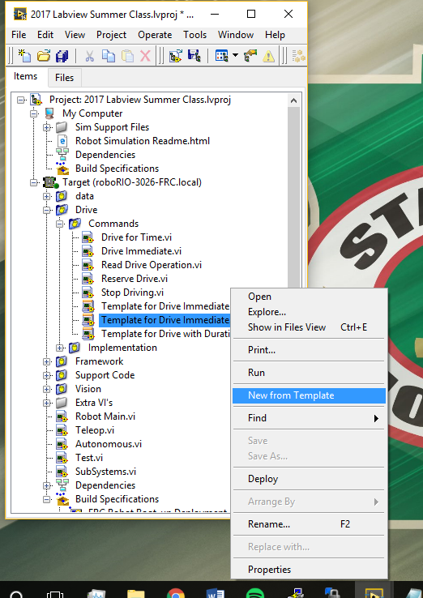
Making a new command
You will write click on one of the templates and click on make new from template.

Slide 13
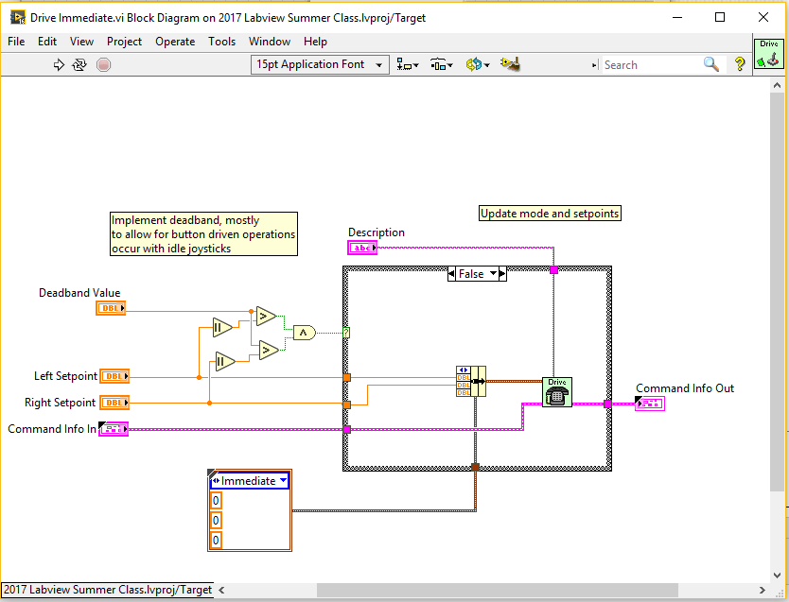
Standard Drive Immediate Command

Slide 14
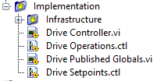
Implementation
These is where you will execute actions that your command calls
All movement on the robot is executed here
In C++ these are known as source file example.cpp

Slide 15
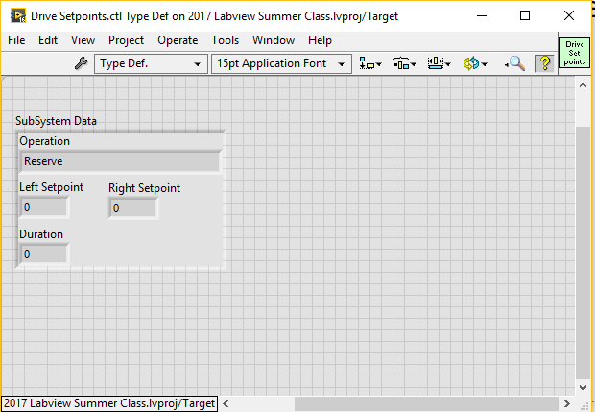
Setpoints
Values you want to pass into command
Can be any data type

Slide 16
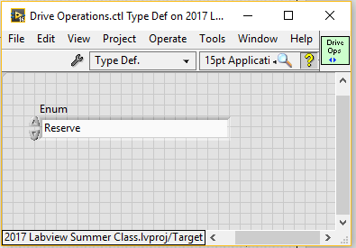
Operations
This is all of the names of things the robot can do
GIVE IT A MEANINGFUL NAME!!!!
Ex: Robot Centric Drive Immediate
Move

Slide 17
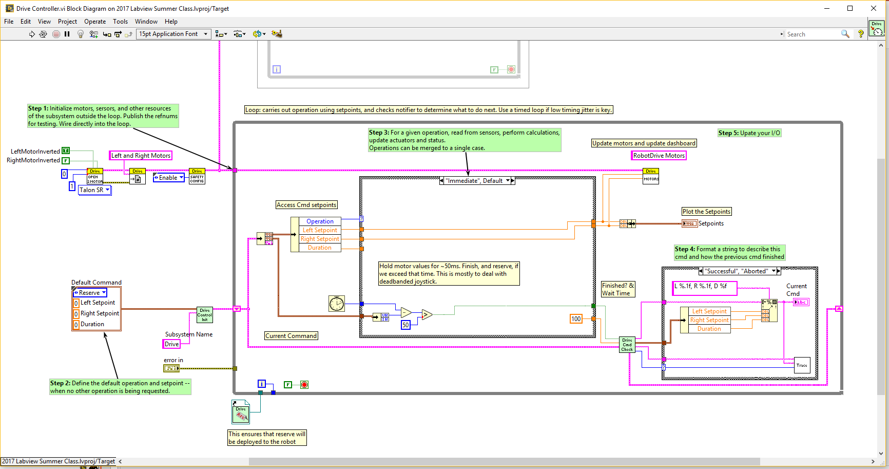
Controller
This is where you program what each operation does
This is where the magic happens

Slide 18
Command
Setpoints
Operation

Slide 19
Project 3
Initialize 2 joysticks
3 Axis + slider (in total 4 axis)
12 Buttons

